Slide 1
Prime Software
Mckenzie Busenius
Jiahao Li
Sana Khan
Mfonisoabasi James

Slide 2
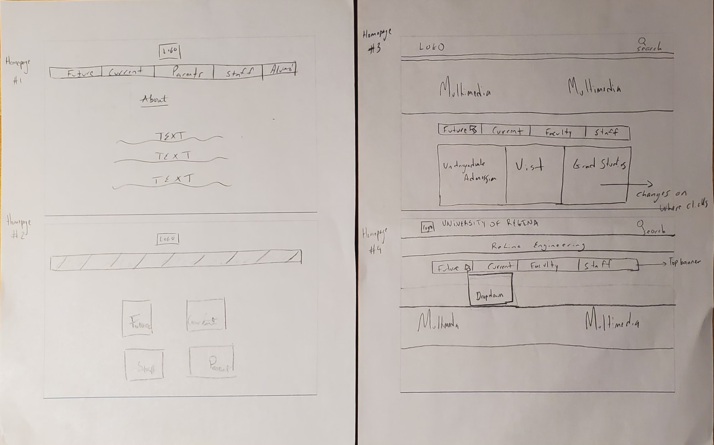

Homepage
Notes:
As a team, we were able to brainstorm through 4 designs for our Homepage, because we would love for our stakeholder to feel right at home when they visit our website. We do feel we could have had more ideations, However to were still pleased that one of our designs was well received by the stakeholders, Design 3 (HomePage 3, our dynamic homepage design), which we would try to implement most since it was the most preferred.
So, for our first MVP, ease of use was the driving force behind our focused designs as demonstrated here with our future students path with the goal of applying into the faculty
So now i’m gonna pass it over to my colleague jia hao to talk more about parents

Slide 3
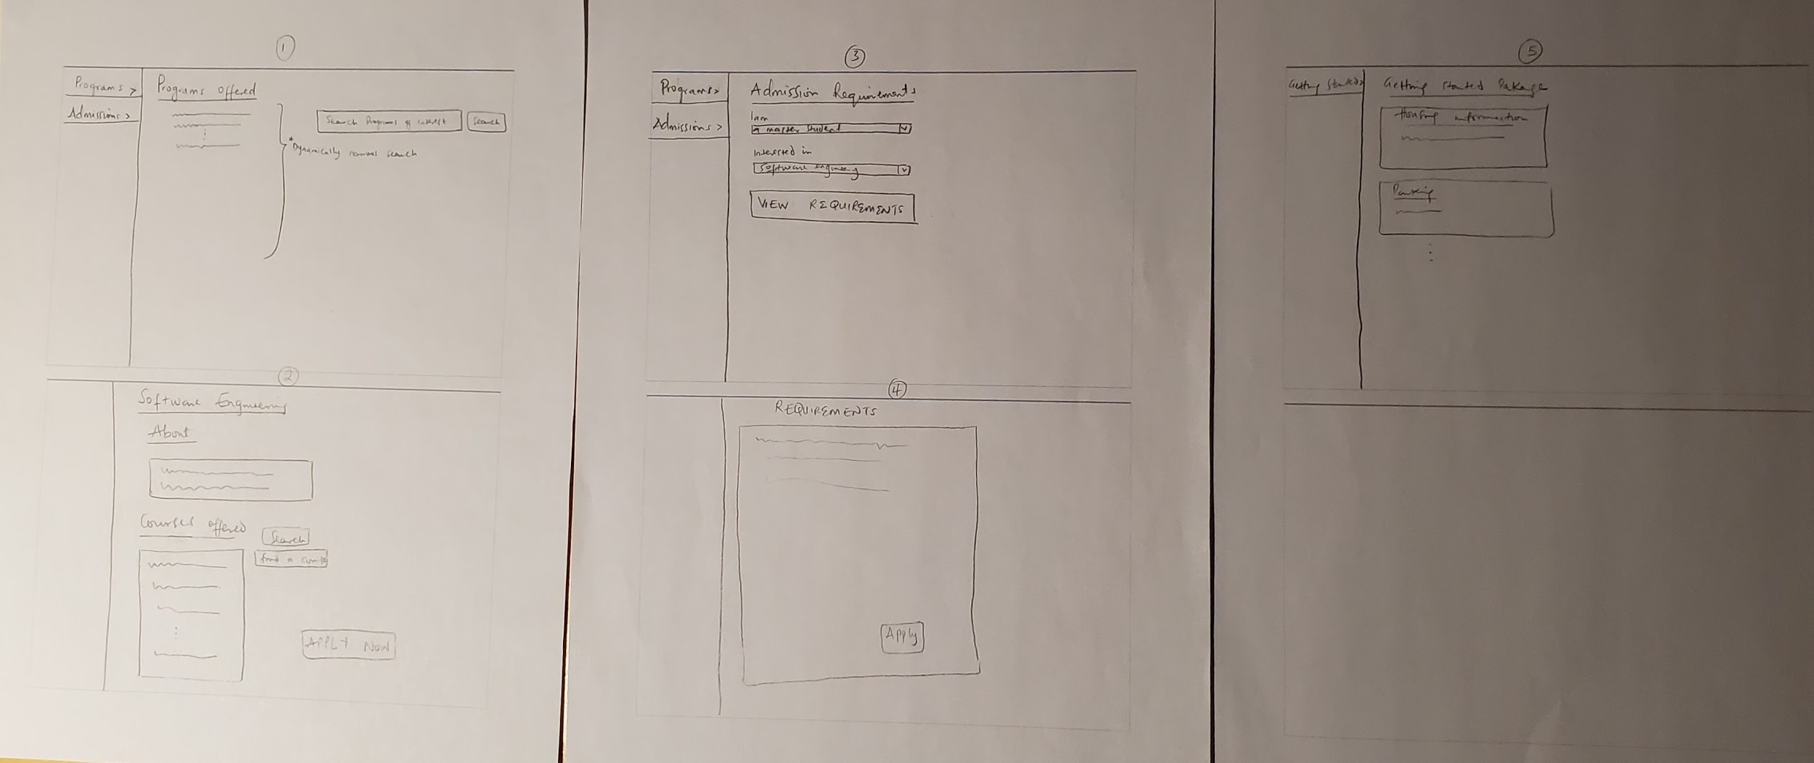
Future Students
Notes:
MJ: hi

Slide 4
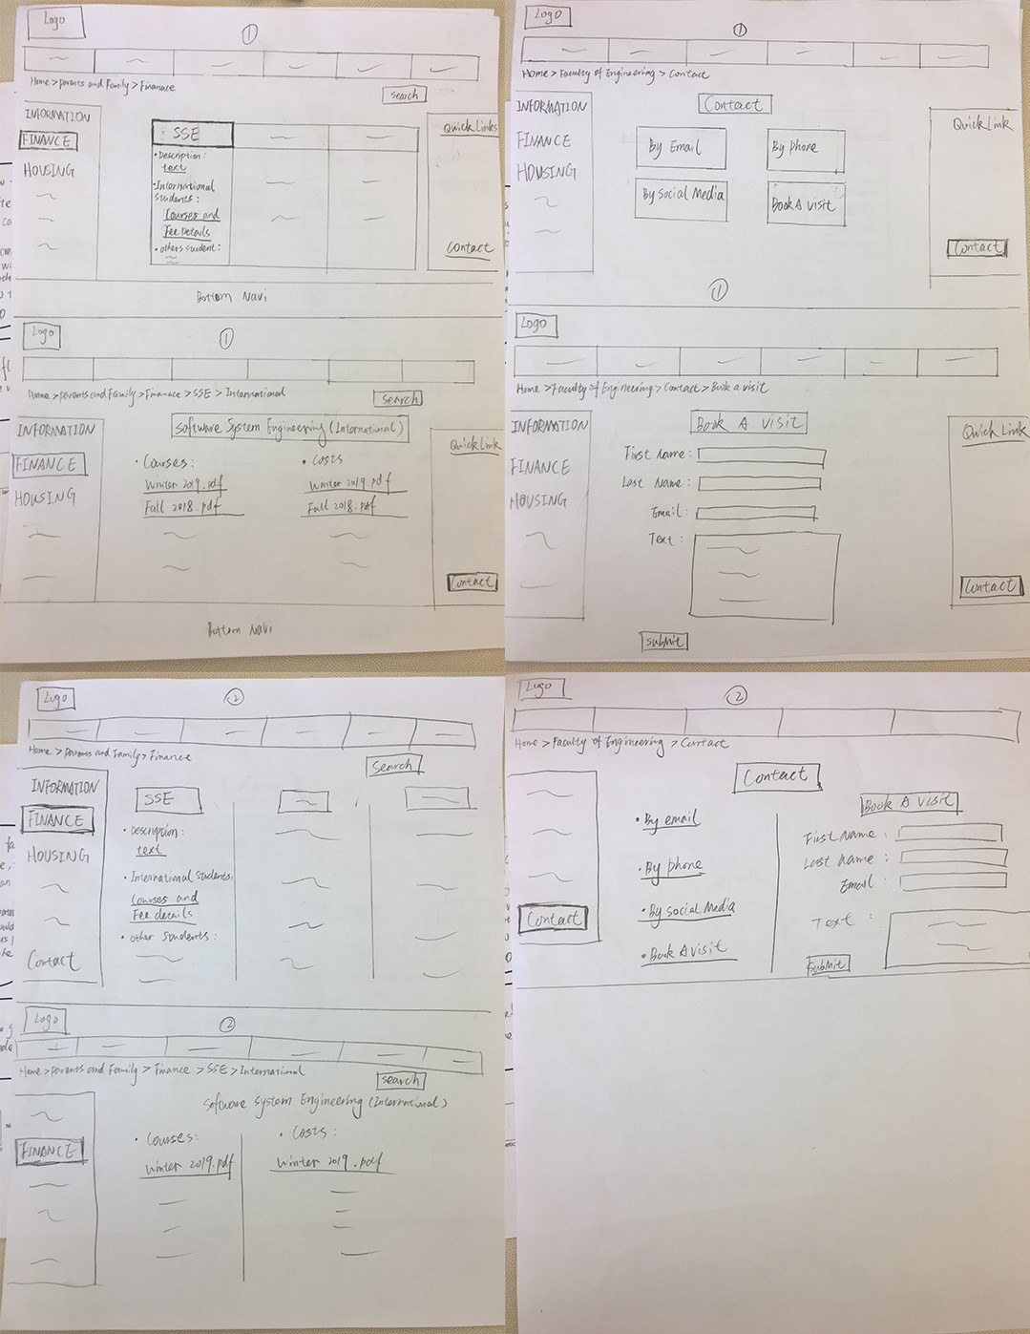
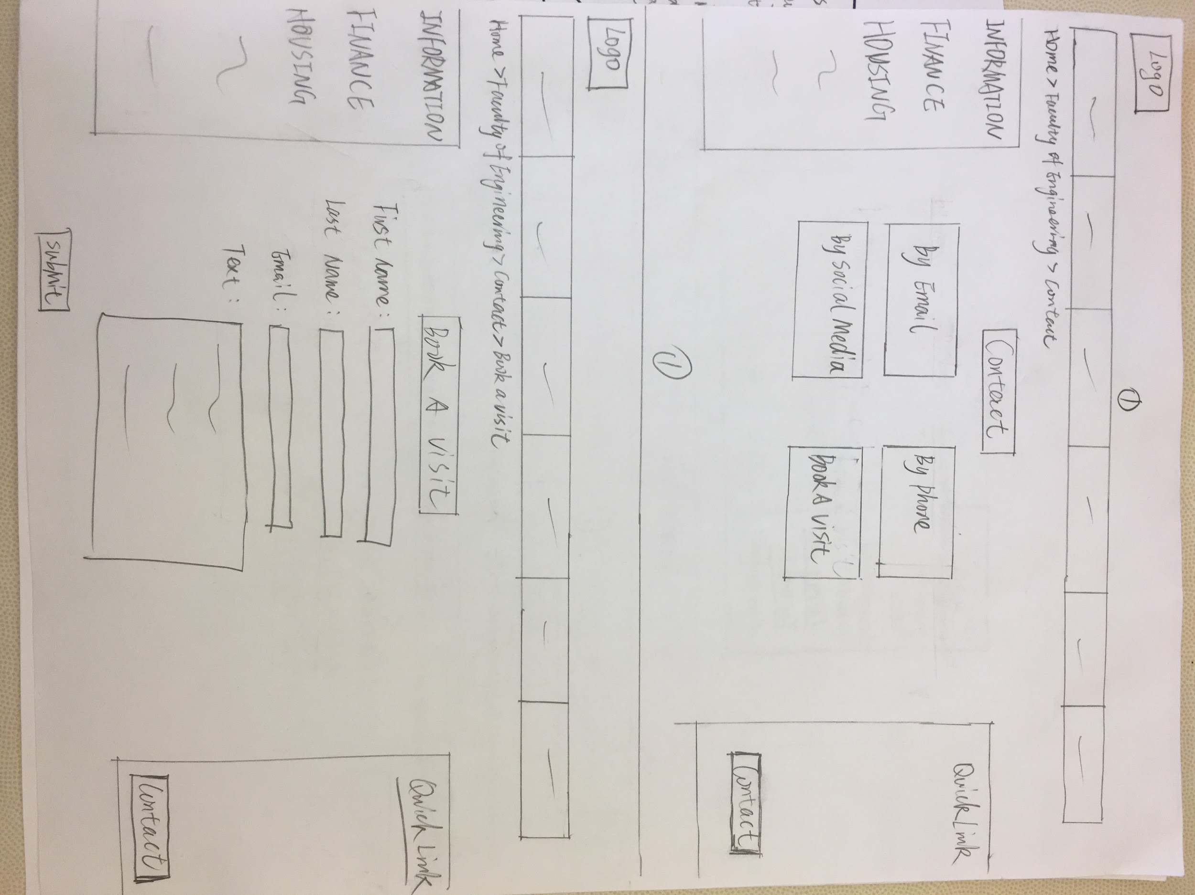
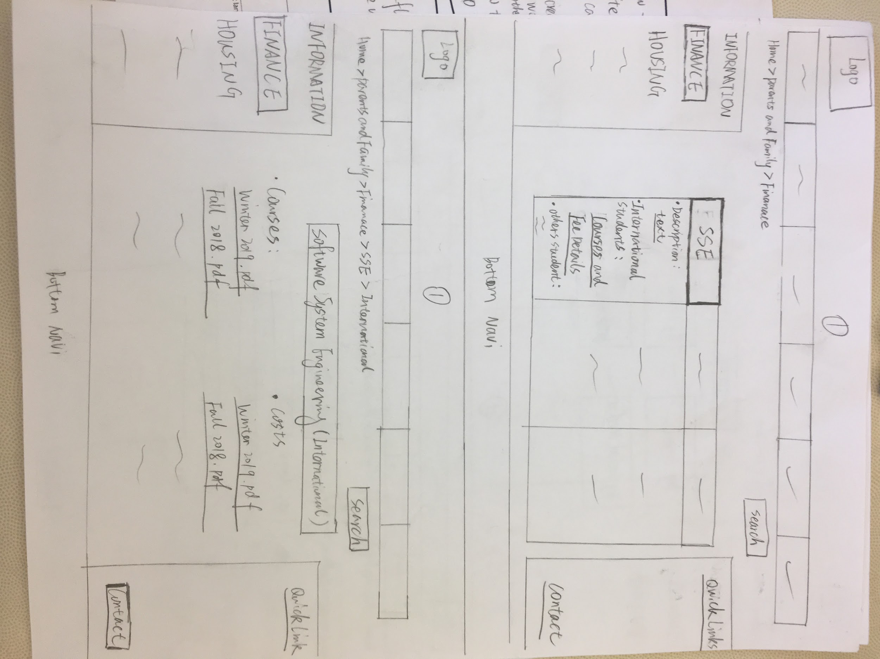

Parents
Focused idea:
Notes:
Jiahao - parents
This picture represents multiple ideas i came up with parents.
Make it different looks to show ways to find right info

Slide 5
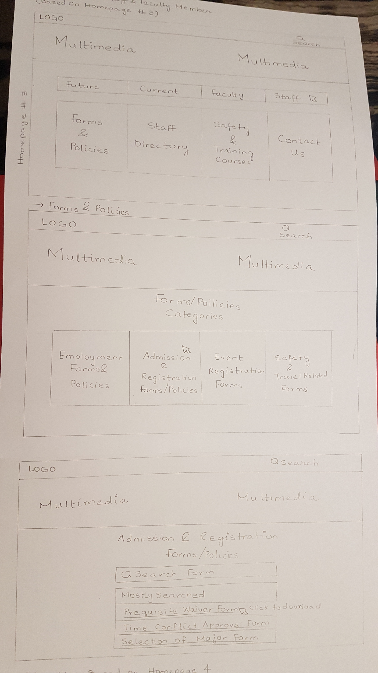
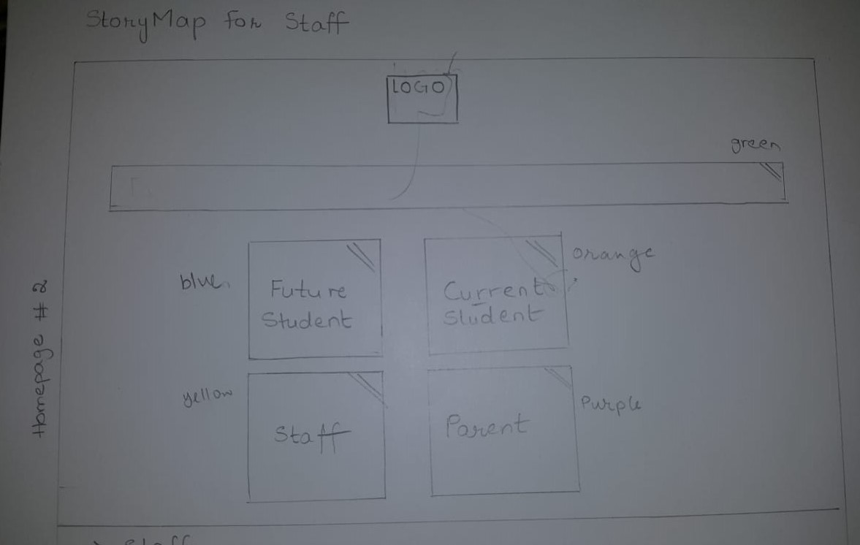
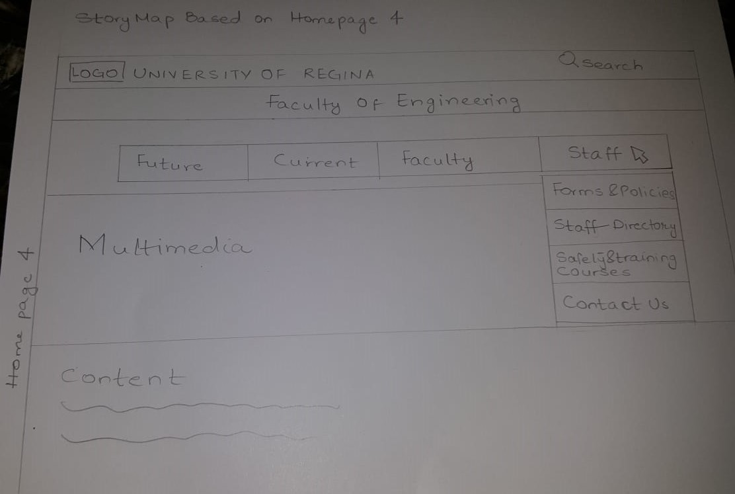
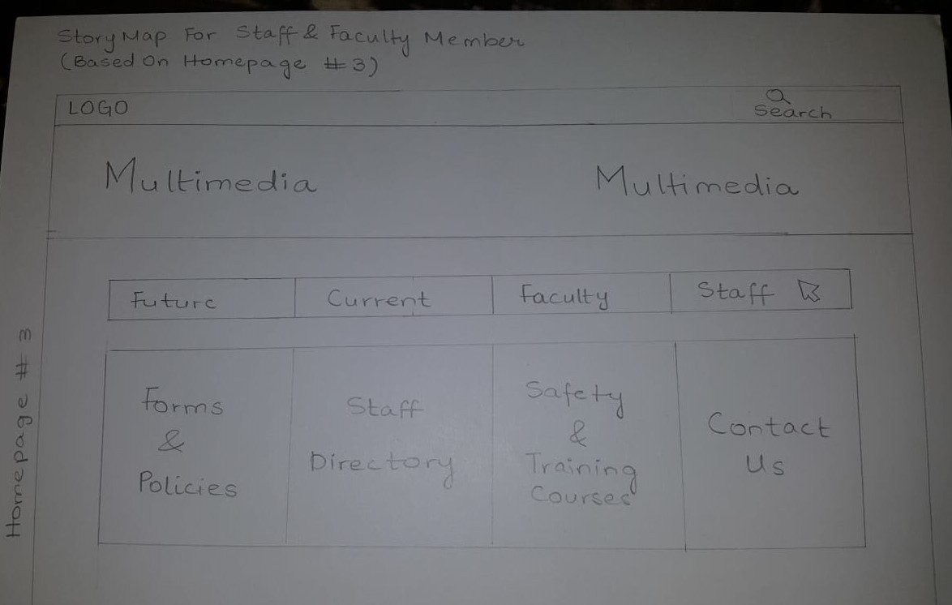
Staff
Focused Design
Notes:
Sana:

Slide 6

Digital Constraints
Limitations of Cascade Server
Retrieving data from offsite
Site maintenance and updates
Notes:
Sana:

Slide 7
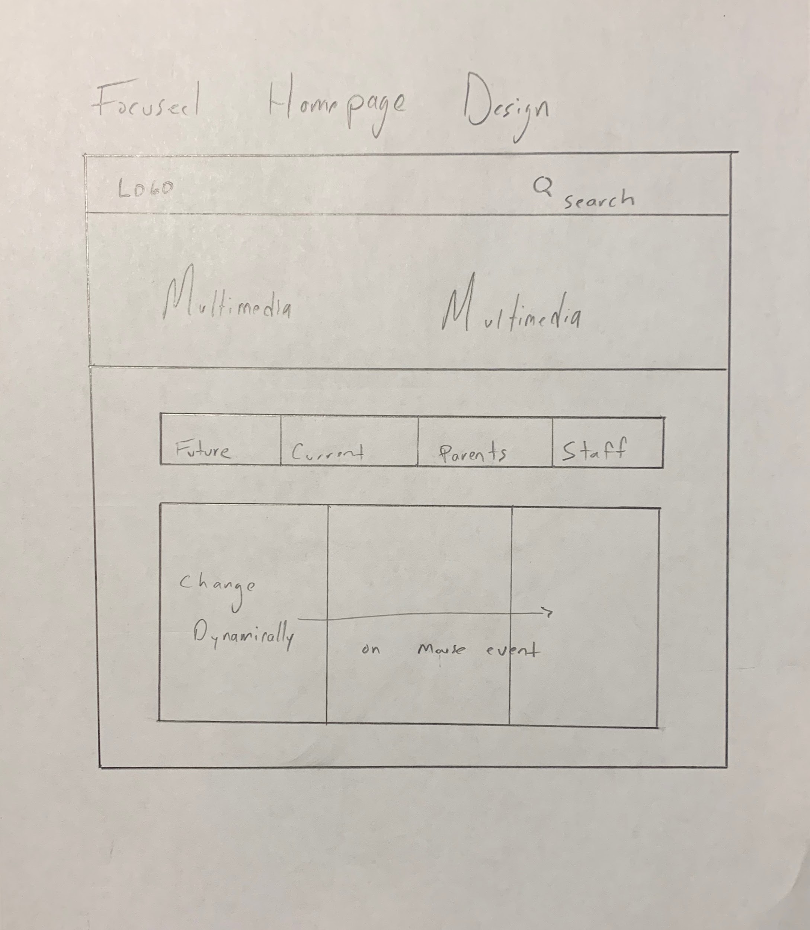
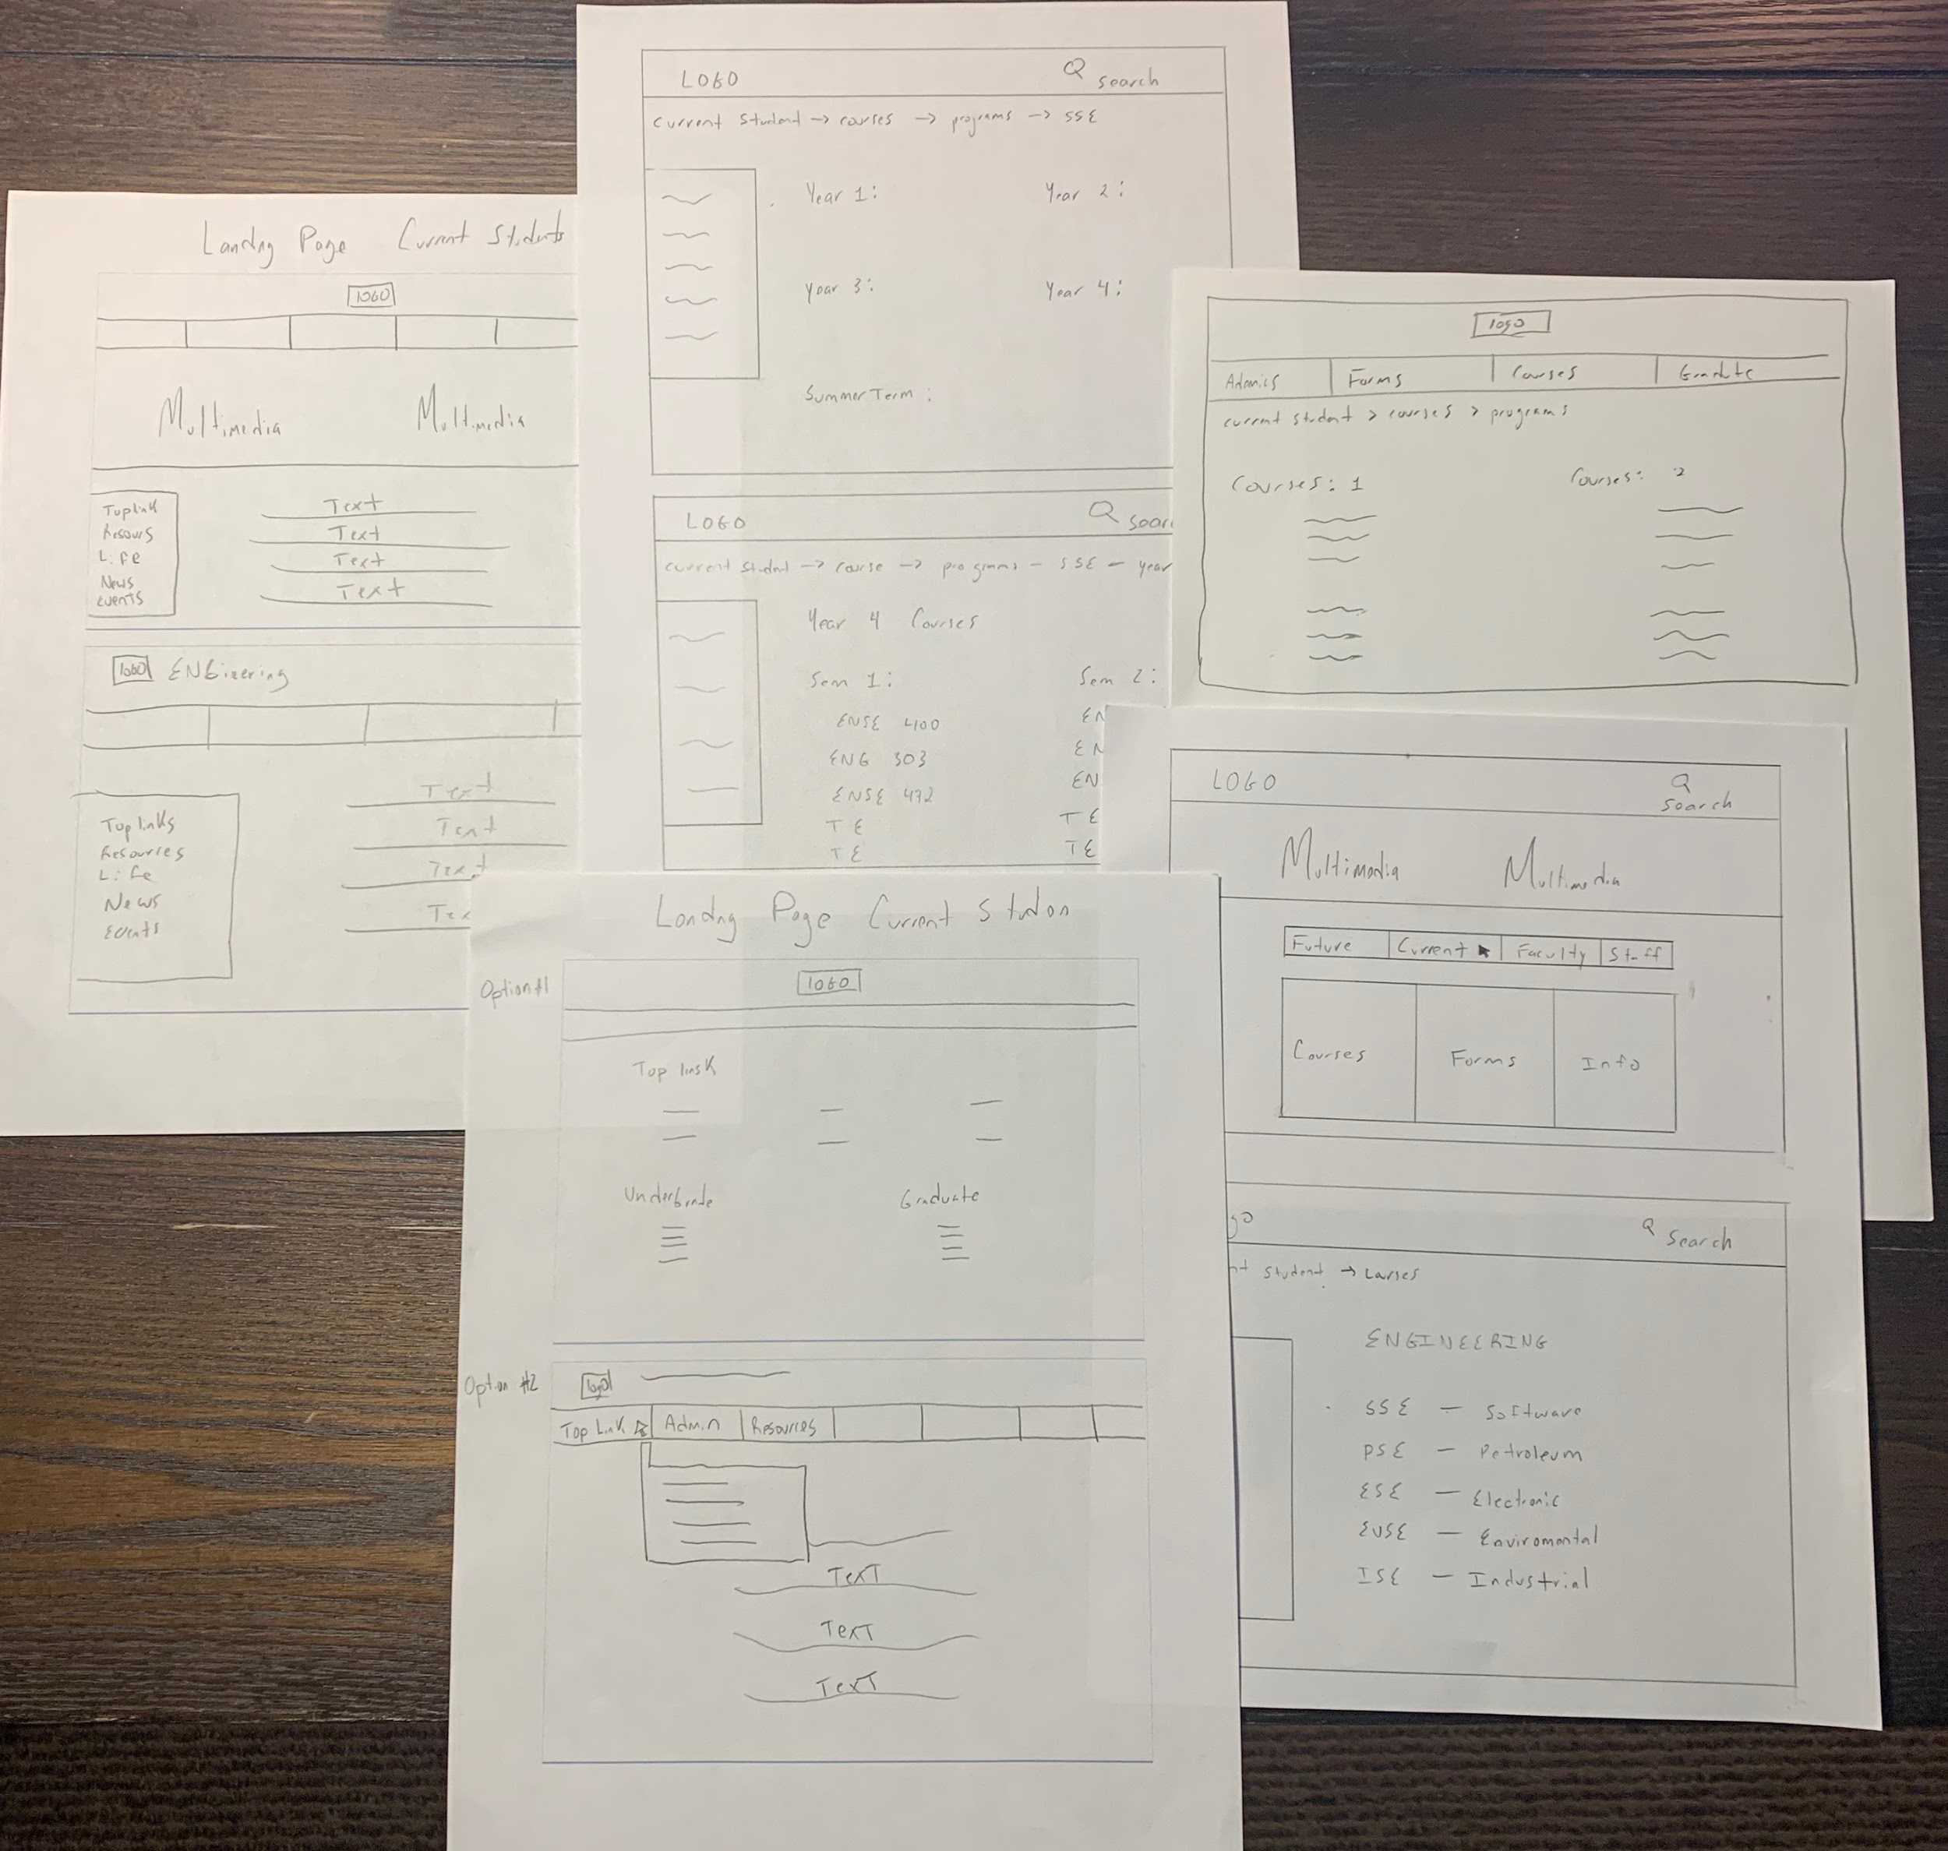
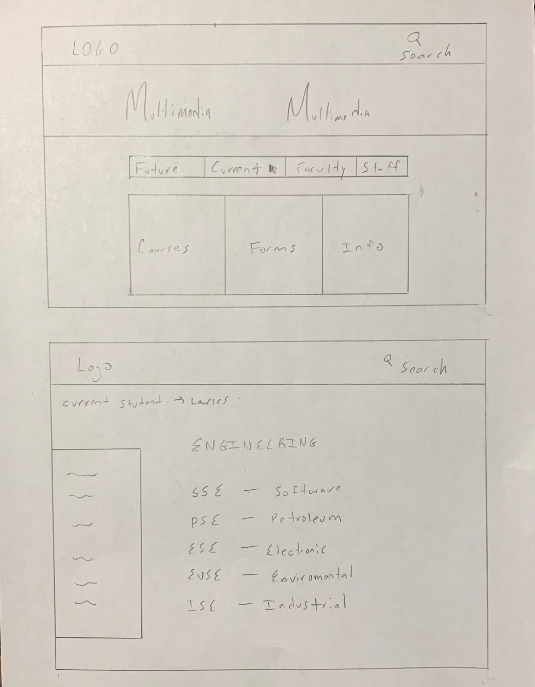
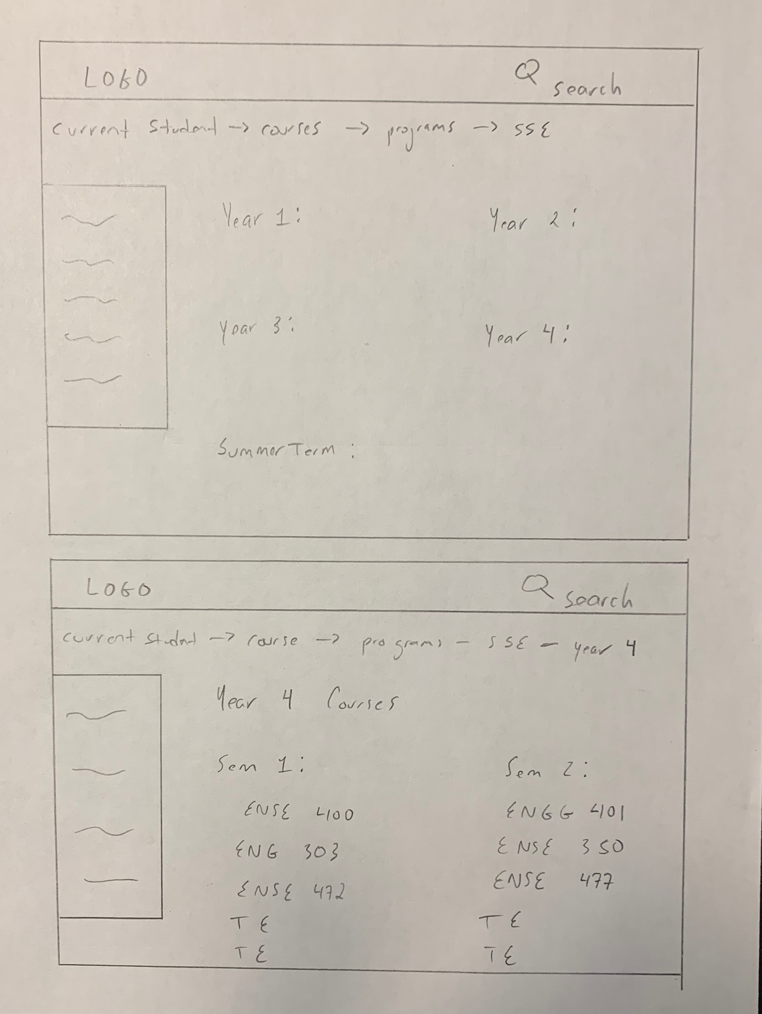
Current Students
Notes:
Mckenzie:
Again the picture to the left represents multiple possible perspectives for current students.
The sequence of pictures to the the right represent a example path using our focused design for a current student keeping in mind the preferred target customer home page design

Slide 8
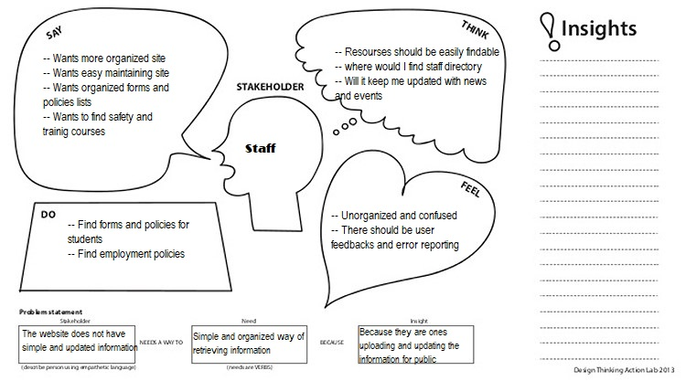
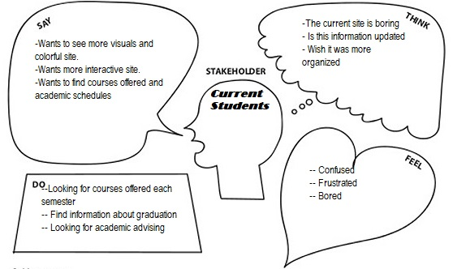
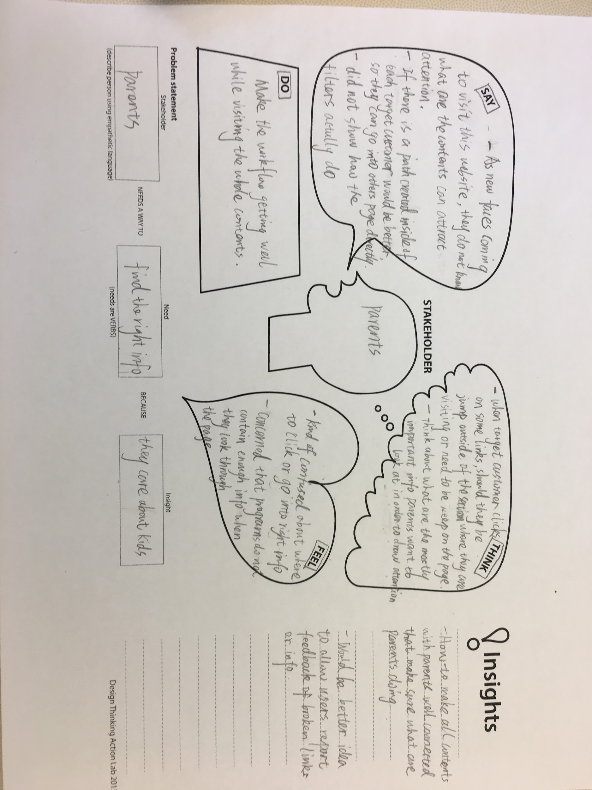
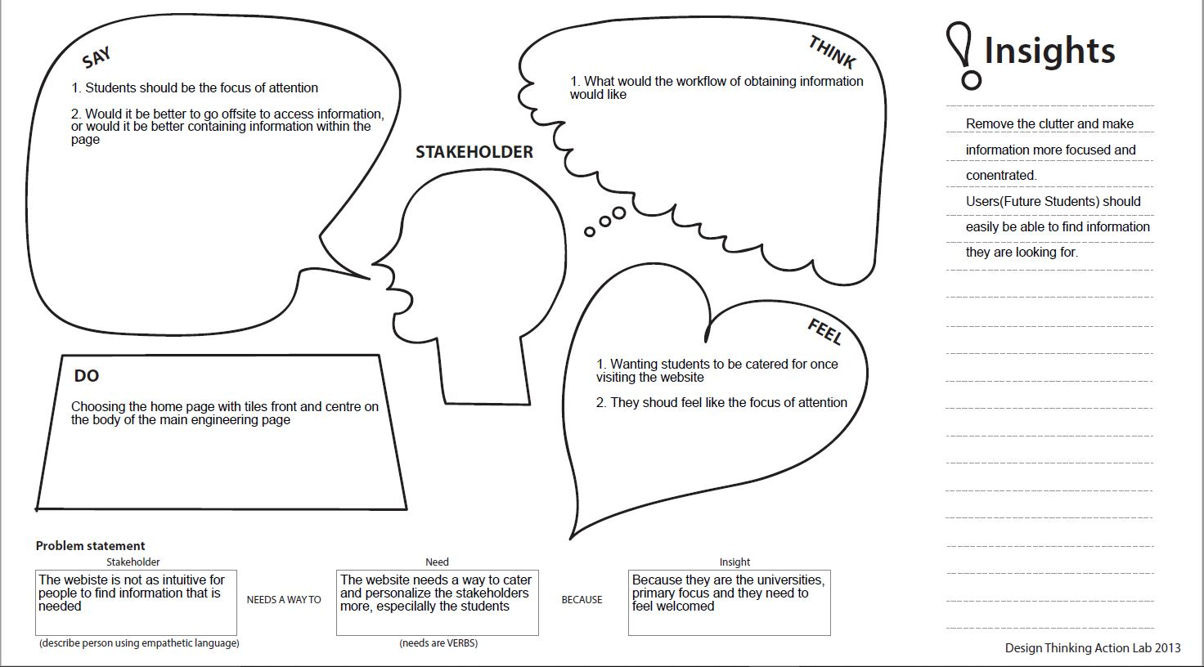
Notes:
So here are empathy maps gathered from our various stakeHolders

Slide 9
Evaluation
Feedback:
To consider -> offsite or keep onsite (information)
Maintain the content
Make sure the students feel the most important
Pros - Receiving valuable feedback to focus on improving design ideas
Cons - Not enough time to get all the needed information
Notes:
Mckenzie:
The most important feedback received was:
1 - To consider the problem to keep data on or off site
2 - Focus on improving the ability to keep the content up to date
3 - that the student need to feel valued when searching for information
The pros with working with the focus group was the ability to connect with the customer and receive feedback about our ideas
The cons was that to try and get all the valuable info for each target customer was challenging

Slide 10
Usability Questions
Future students
q1. find the grade requirements needed for software engineering
q2. what is the fee structure for an international student
q3. find out what kind of scholarships are offered
q4. find when the admission deadline is
q5. find what how much housing is on campus
Notes:
As a team, here are just a few of the many usability questions we were able to come up with and we would love to focus in on “Q1” for the sake of our presentation, where are future student is tasked with finding a grade requirement.
Now taking a look at our USM with a little bit of revision on our first MVP, we found that both future student and parents are interconnected so we decided to deal with them together, As they could have similar goals but may pose different questions
….(walking through USM)
So the goal here for the stakeHolders is to apply for
A future student could be thinking about how to get into the faculty whereas a parent could be thinking about how does my kid get into the faculty
So now im gonna pass it over to my colleague to talk about our github

Slide 11
USM
https://landofooo.storiesonboard.com/m/prime-software

Slide 12
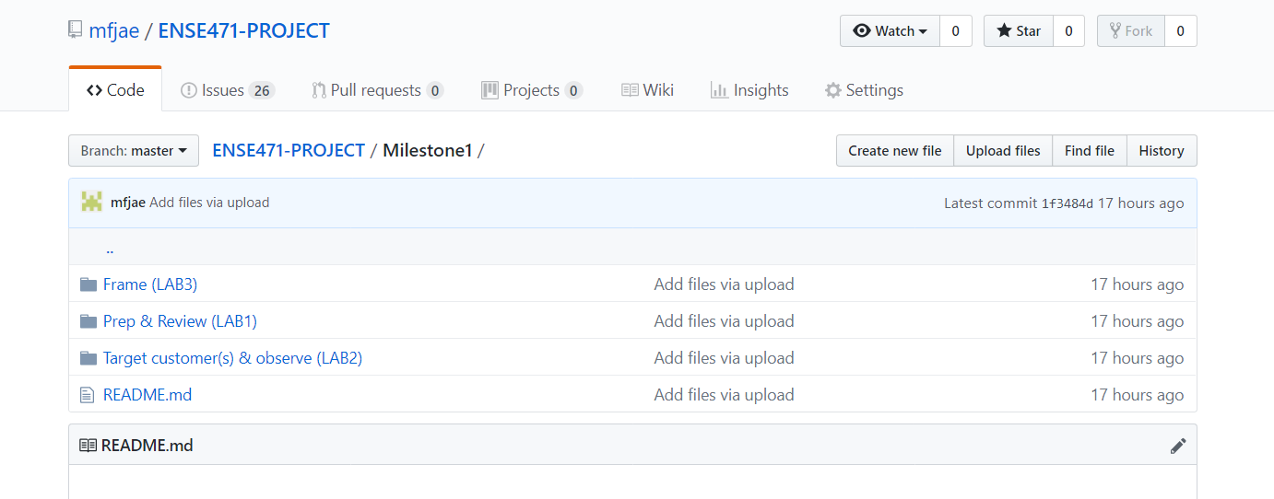
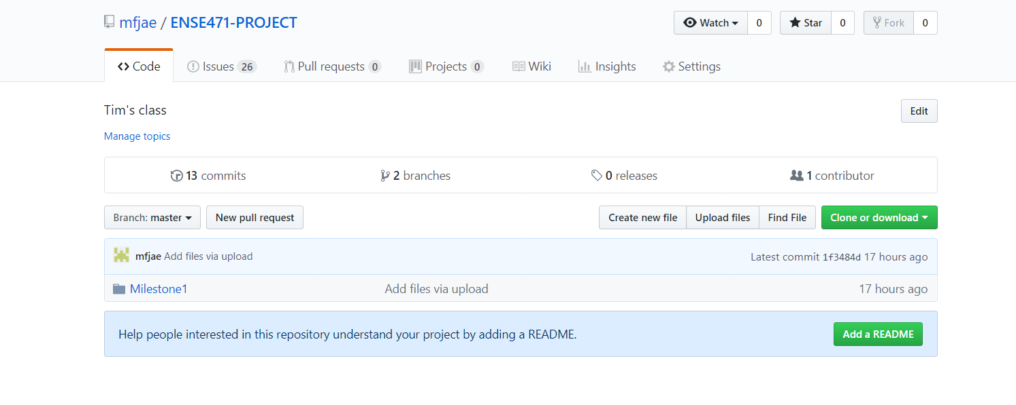
GIT Hub Review
Notes:
@sana
Folders are labeled their various milestones and within them are sub folders of the information gathered in respective labs

Slide 13
Group Reflection
•How did you feel about this milestone? What did you like about it? What did you dislike?
One of things that was interesting was how we played with different ideas.
•What did you learn about yourself as you collaborated and worked through this milestone?
We argued a lot mostly on how to organize our content and ensure it was within 6 mins.
•How will you use what you have learned going forward?
We also learned how to deeply communicate with each other, expressing our ideas and comments to one another.
•What “stuff & things” related to this milestone would you want help with?
It is fair enough.
Notes:
Jiahao - Group Reflection
One of things that was interesting was how we played with different ideas.
We argued a lot mostly on how to organize our content and ensure it was within 6 mins.
We also learned how to deeply communicate with each other, expressing our ideas and comments to one another.
It is fair enough for doing currently things.

